Slide 1

History of Speedrunning
Brennen Boldt

Slide 2


What is Speedrunning?
• There are many ways to play video games, but one of the most interesting ones is speedruning.
• Speedrunning is the art of playing a game under specific conditions as fast as possible.
• Because the goal is to go as fast as possible use of glitches, exploits, and sequence breaking is commonplace.

Slide 3
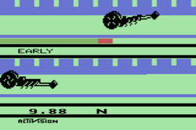
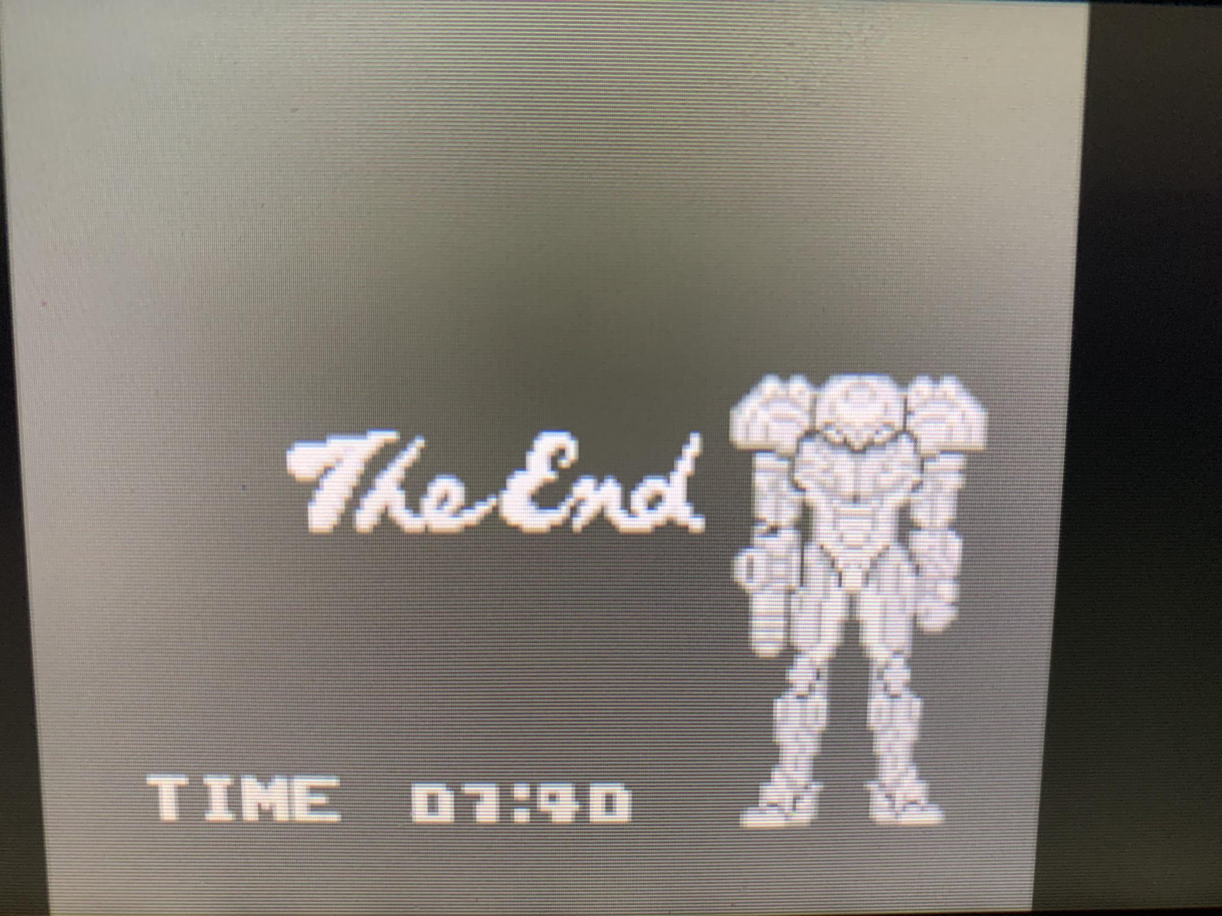
What were the first Speedruns?
• Speedrunning has been around as long as video games have been around.
• One of the earliest examples of speedrunning was in the early 1980's with Activision's magazine, Activisions.
• This was restricted to games with in-game timers, such as Dragster, Metroid II, Activision's Grand Prix, etc.
https://atariage.com/magazines/activisions.php

Slide 4
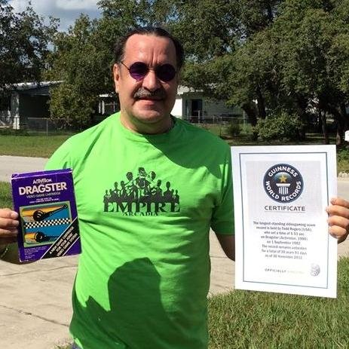
Issues with early Speedrunning
• There was very little to prevent cheating in early speedruns.
• Without access to the internet and the code of games, it wasn't possible to disprove someones run.
• One of the most prevalent record holders in the early ages of speedrunning, Todd Rogers, turned out to have cheated for his records.

Slide 5
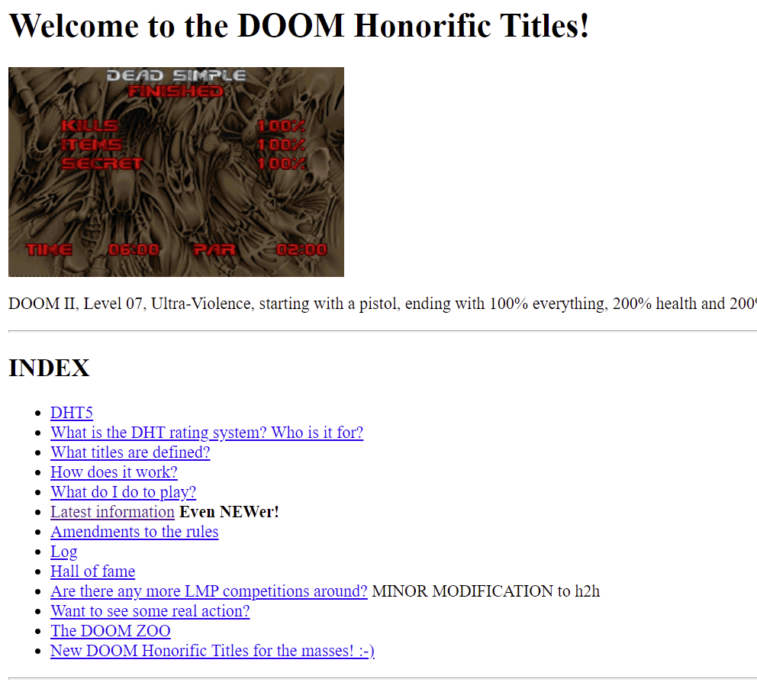
The Start of the Internet
• During these times, speedrunning was very unofficial, leading to lack of competition.
• That changed with the birth of the LMP Hall of fame and Doom Honorific Titles Websites.
• These were websites used for tracking speedruns for Doom 2.

Slide 6
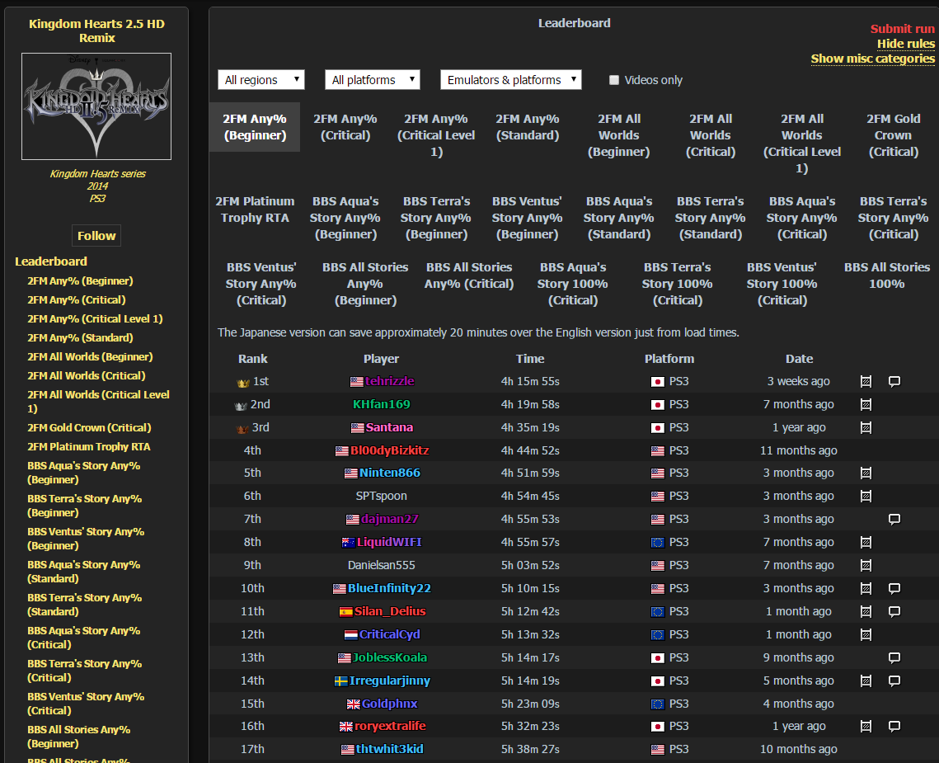
Integrating the Internet
• With the boom of the internet, speedrunning started to integrate the Internet.
• Larger and better designed websites started to pop up, such as SpeedRunLives.com and Speedrun.com.
• It has also become commonplace to stream speedrun attempts, which has reduced cheating in the community immensely.

Slide 7
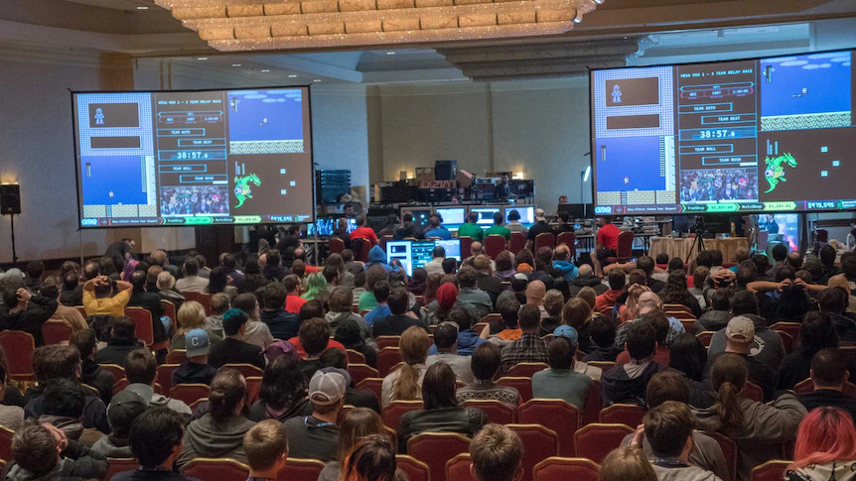
Games Done Quick
• In 2010, Mike Uyama founded the Games Done Quick speedrunning charity event.
• GDQ is a biannual event in which speedrunners come together to show off different games to raise charity.
• There have currently been 33 events under the GDQ name, and they have raised over $34 million for different charities.
https://gamesdonequick.com/tracker/

Slide 8
Speedrunning Today
• Speedrunning has blown up in the past few years and has become more accessible than ever before.
• There are multiple ways to do speedruns, such as multisegmented runs, races, and TAS's.
• The speedrunning community is incredibly open and accessible.

Slide 9
Works Cited
Shanley, Patrick. “How an Event Dedicated to Playing Video Games as Fast as Possible Raises Millions for Charity.” The Hollywood Reporter, The Hollywood Reporter, 4 Jan. 2019, https://www.hollywoodreporter.com/movies/movie-features/how-games-done-quick-raises-millions-charity-1172902/.
Wang, Amy B. “A Man Accused of Cheating at Video Games May Lose His Guinness World Record.” The Washington Post, WP Company, 29 Apr. 2019, https://www.washingtonpost.com/news/early-lead/wp/2018/01/29/a-man-accused-of-cheating-at-video-games-may-lose-his-decades-old-guinness-world-record/.

